Slide 1
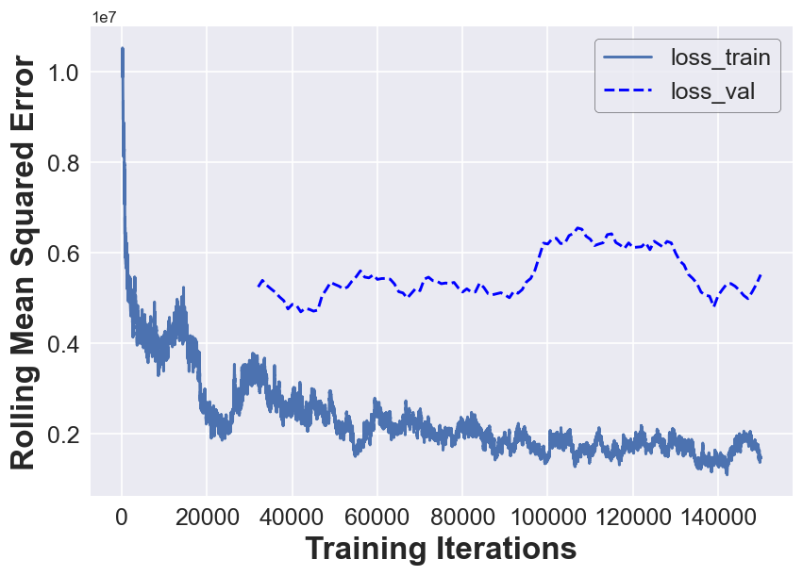
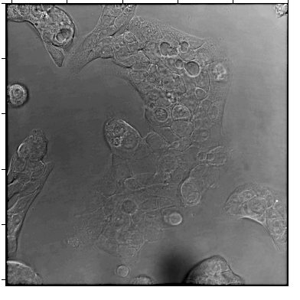
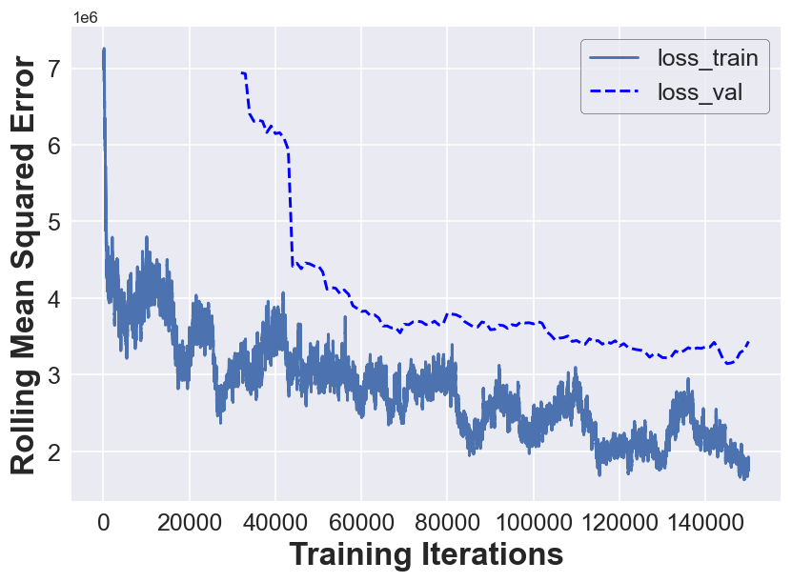
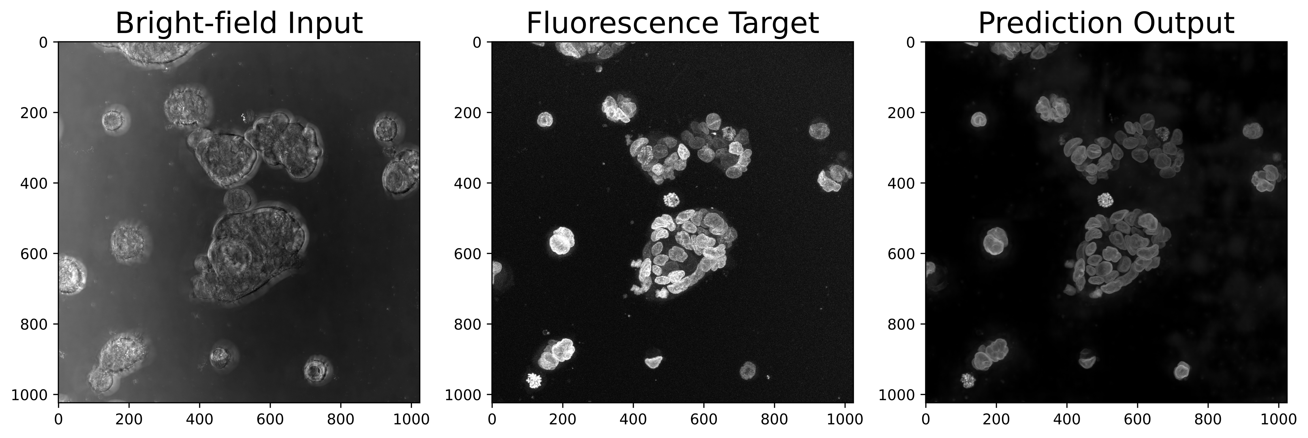
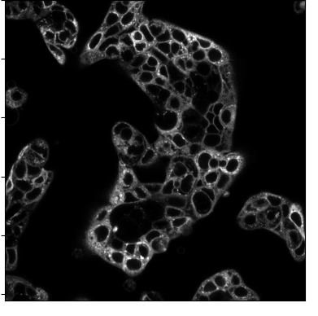
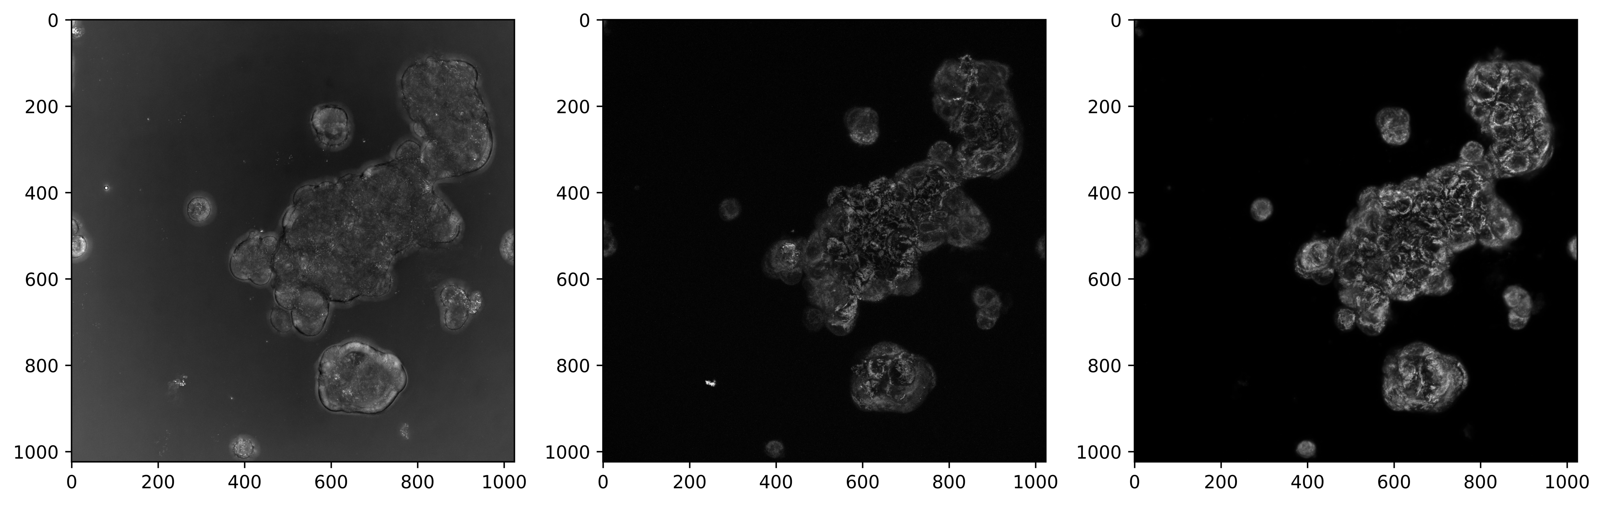
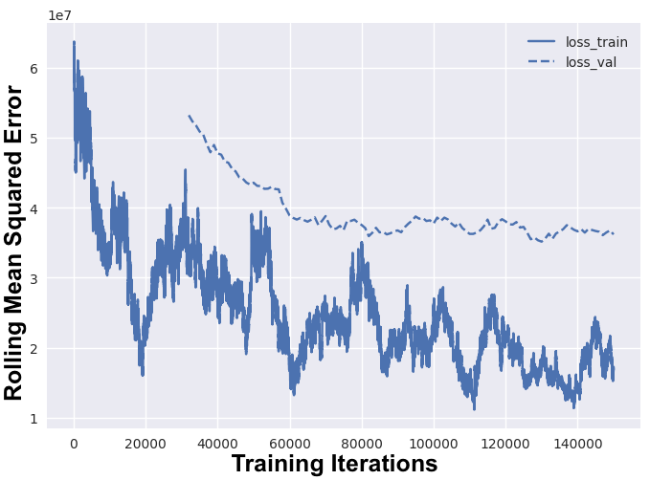
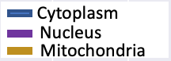
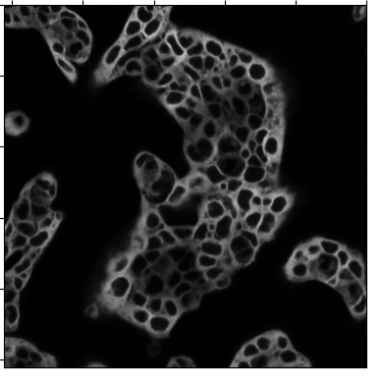
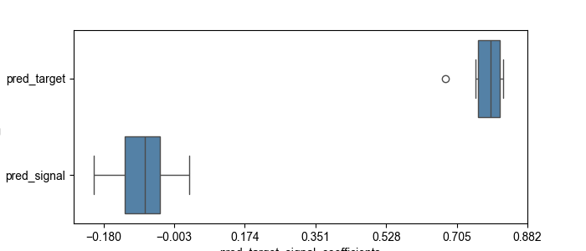
B
A
Nucleus
Mitochondria
Cytoplasm
Bright-field input
C
D
Fluorescence Target
E
P, T –
P, S –
P, T –
P, S –
P, T –
P, S –
Prediction Output
Notes:
Evaluating Model Performance to Predict Various Organelles. Representative paired sets from model training using nucleus (train (N=37) / test (N=5), mitochondria train (N=24) / test (N=5) and cytoplasm train (N=29) / test (N=5) models showing bright-field input, target signal and predicted signal with train/validation rolling mean square error loss graphs. Correlation coefficient of actual vs predicted images paired with correlation coefficient from brightfield for the organelles that were used to train the models.

Slide 2
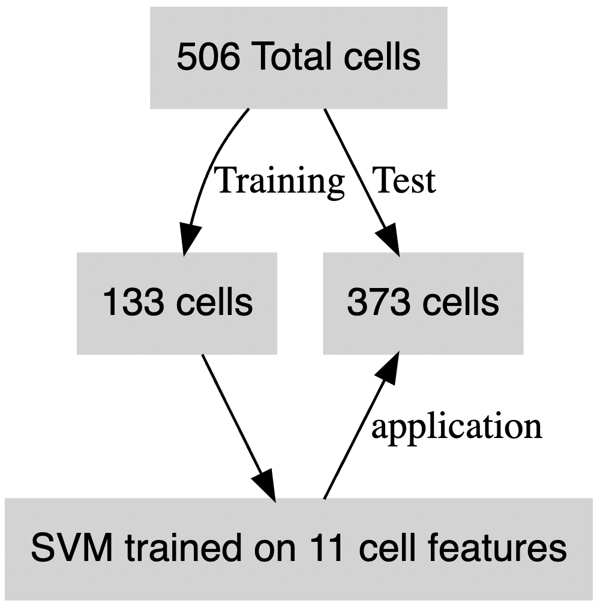

Slide 3
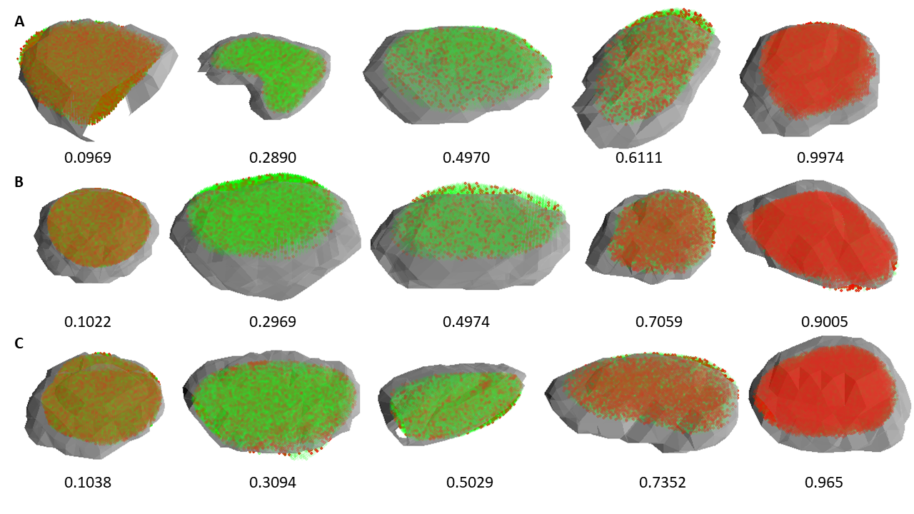

Slide 4
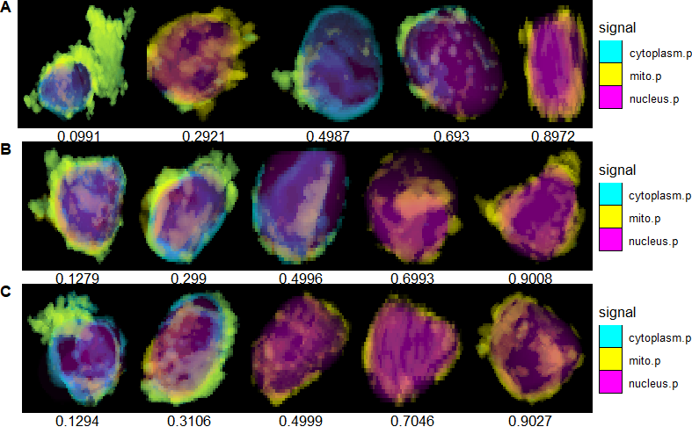

Slide 5
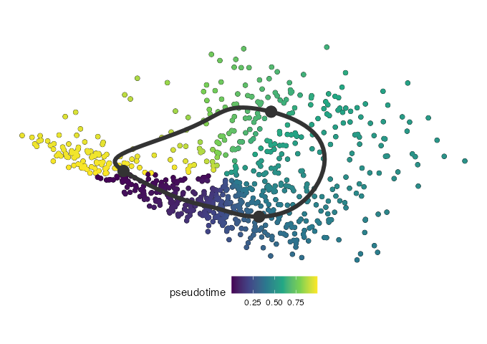
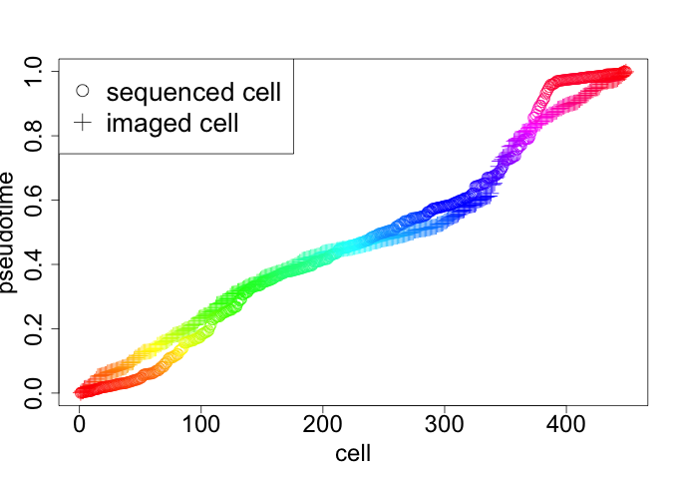
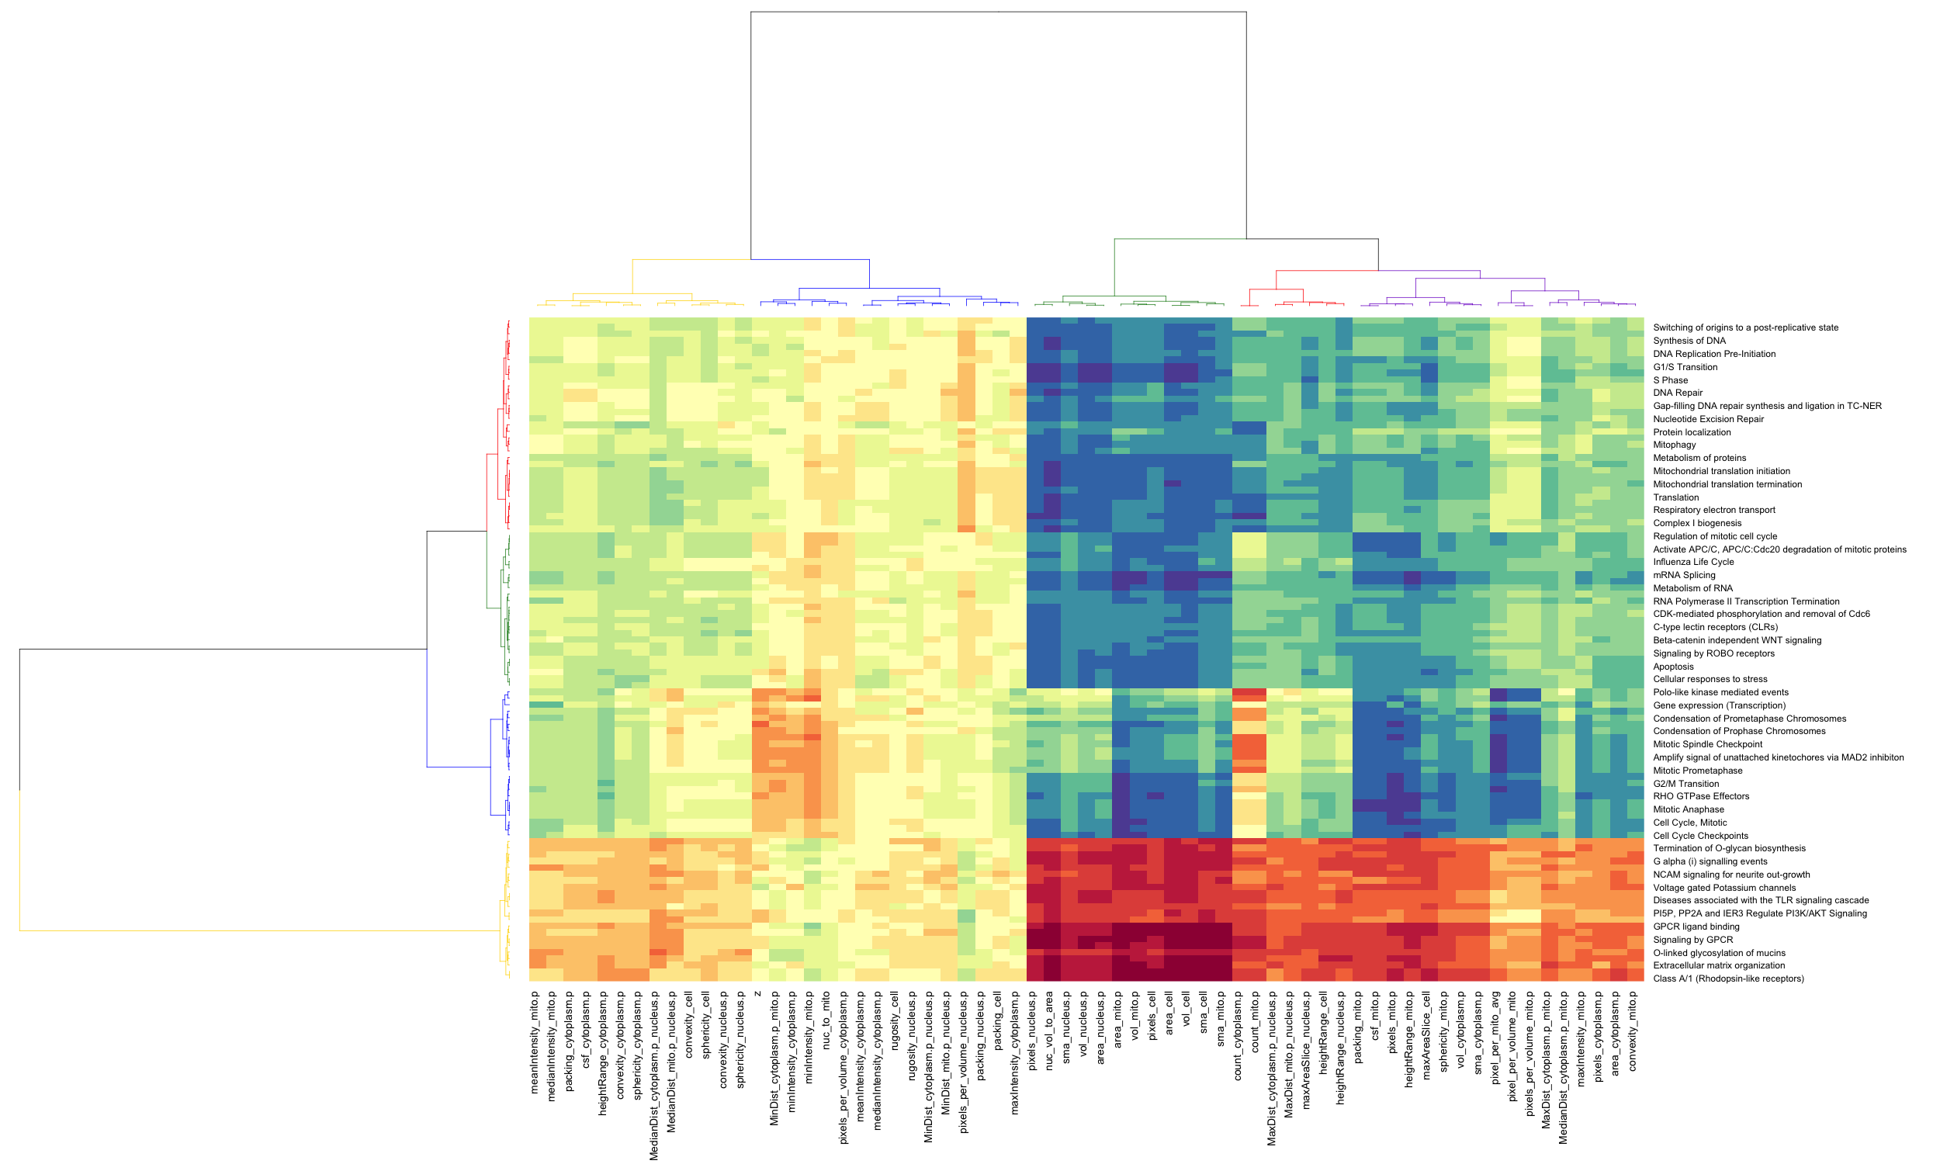
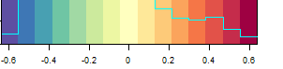
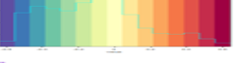
A
B
C
scRNA-seq features
Correlation Coefficient
Image features

Slide 6
